Slide 1
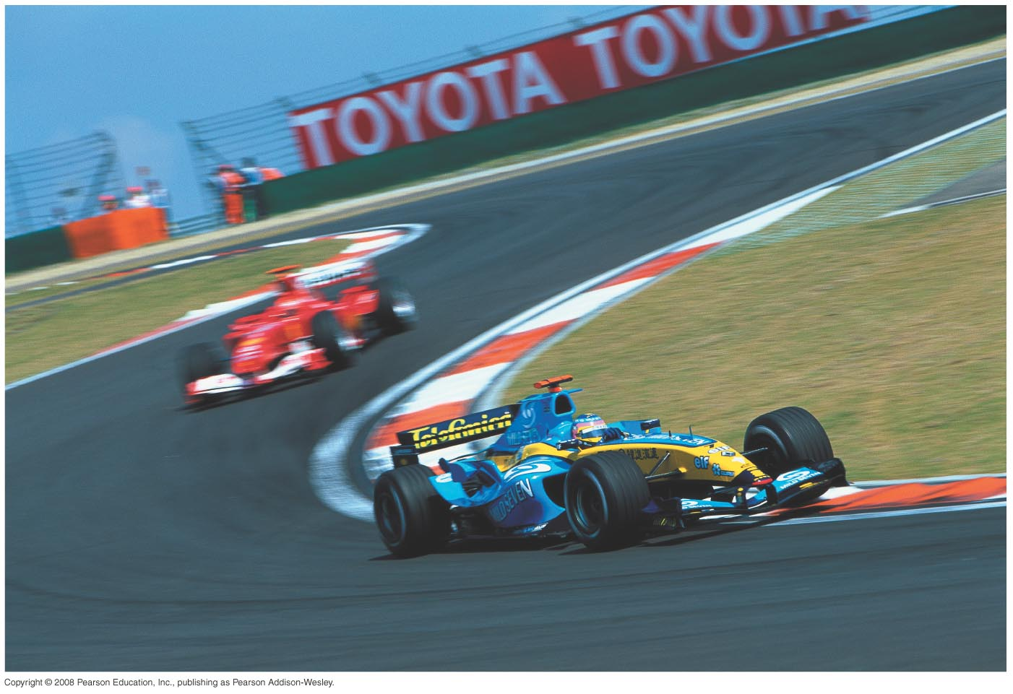

Chapter 3
Motion In Two or Three Dimensions
University Physics 13th edition (Young and Freedman)

Slide 2
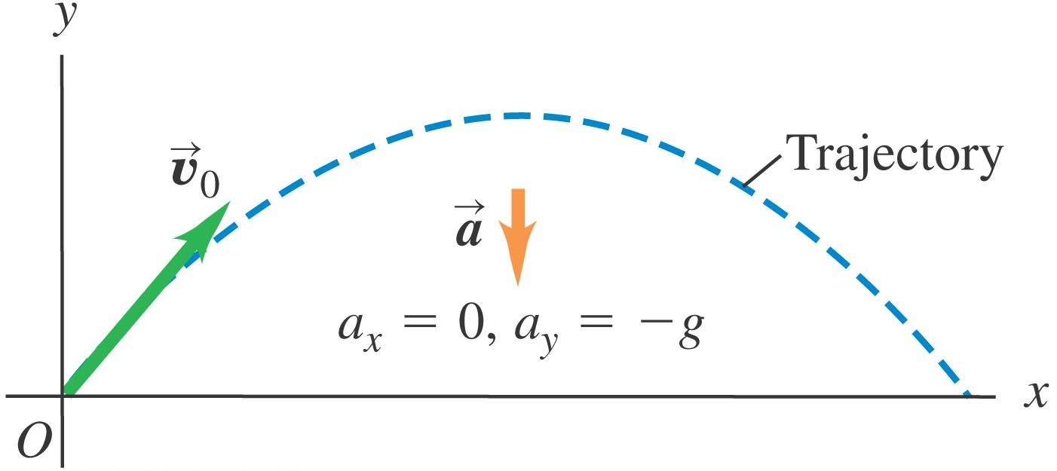


Projectile Motion
Projectile
any body that is given an initial velocity and then follows a path determined entirely by the effects of gravitational acceleration and air resistance

Slide 3
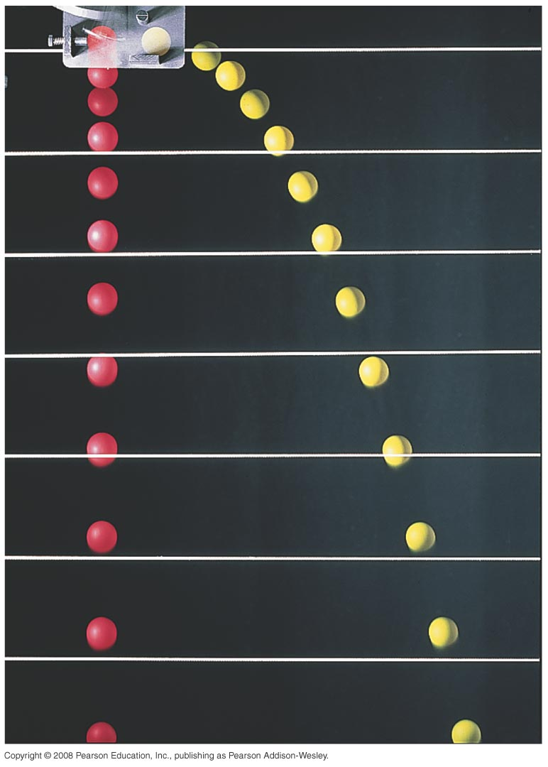
Projectile Motion
Acceleration due to gravity is purely vertical!
i.e. it has no effect on horizontal motion

Slide 4
Projectile Motion
Treat projectile motion as a combination of:
horizontal motion with constant velocity
and
vertical motion with constant acceleration

Slide 5
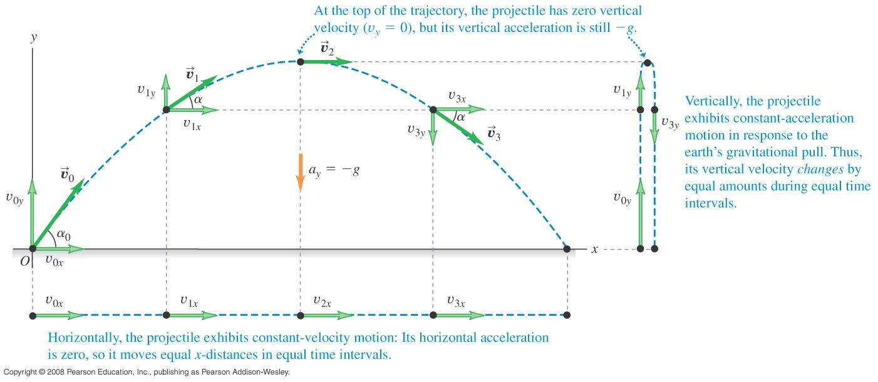

Slide 6
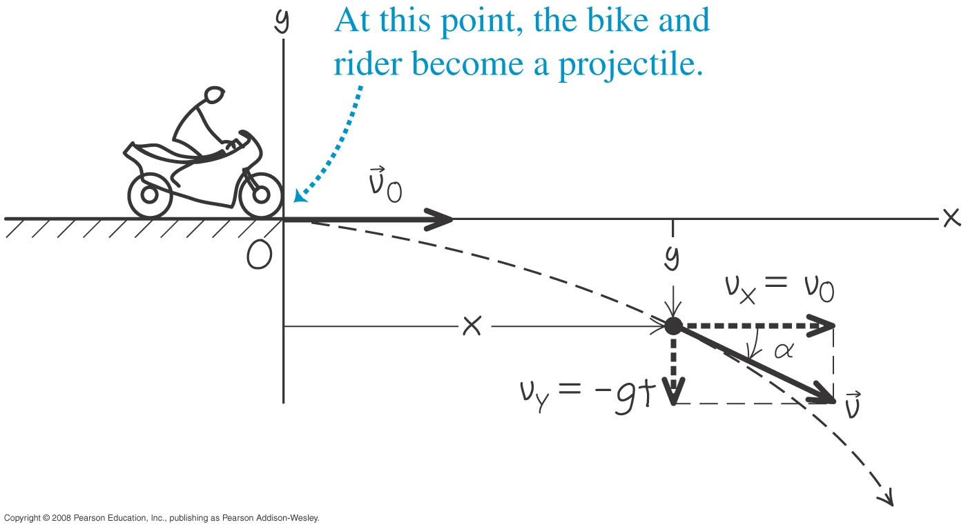
Projectile Motion: The Stunt Rider
A motorcycle stunt rider rides off the edge of a cliff. Just at the edge, his velocity is horizontal, with magnitude 9.0 m/s. Find the motorcycle’s position, distance from the edge of the cliff, and velocity after 0.50 s.

Slide 7
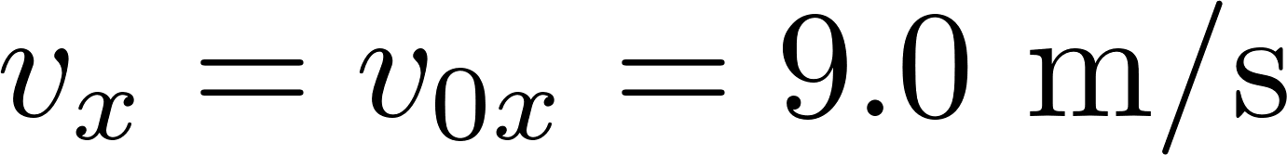
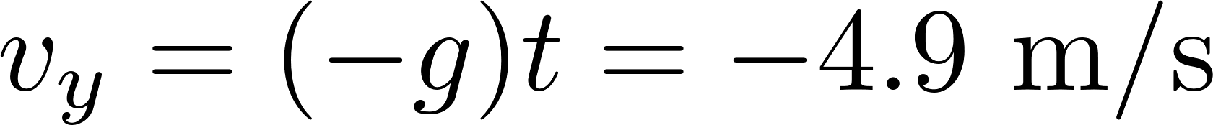
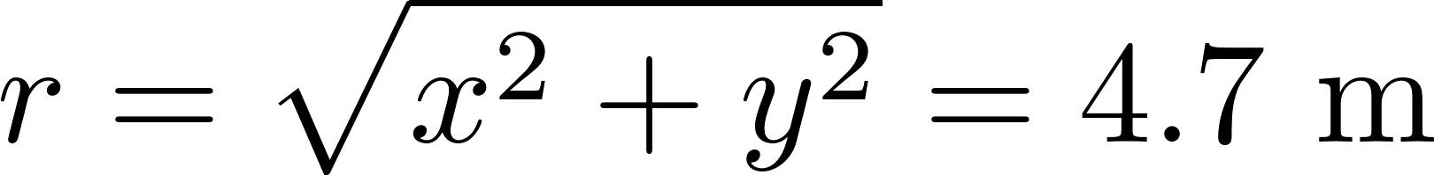
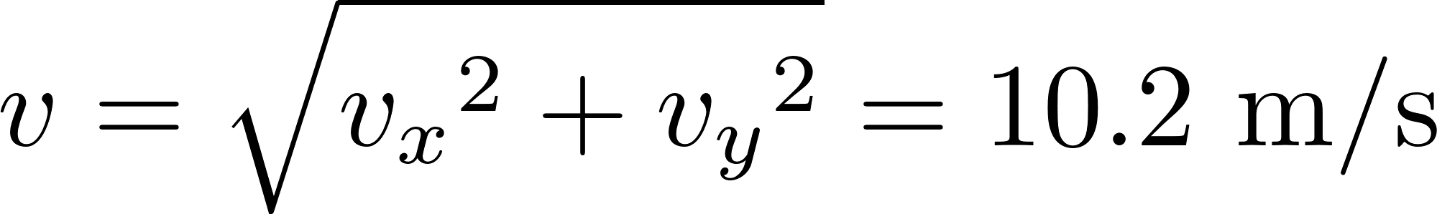
Projectile Motion: The Stunt Rider
r
x = 4.5 m
y = –1.2 m

Slide 8
Projectile Motion: Is it a Homerun?
A batter hits a baseball so that it leaves the bat at speed v₀ = 37.0 m/s at an angle α = 53.1°, at a location where g = 9.80 m/s². (a) Find the position of the ball, and the magnitude and direction of its velocity, at t = 2.00 s. (b) Find the time when the ball reaches the highest point of its flight and find its height h at this point. (c) Find the horizontal range R – that is, the horizontal distance from the starting point to where the ball hits the ground.

Slide 9
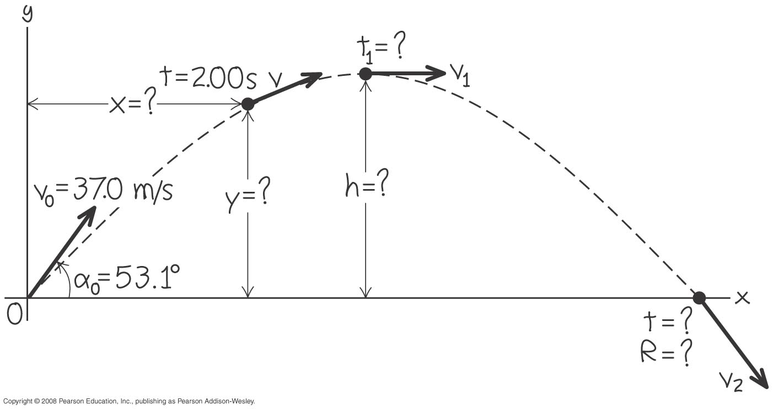
Projectile Motion: Is it a Homerun?

Slide 10
Projectile Motion: Win the Prize
In a carnival booth, you win a stuffed giraffe if you toss a quarter into a small dish. The dish is on a shelf above
the point where the quarter leaves your hand and is a horizontal distance of 2.1 m from this point. If you toss the coin with a velocity of 6.4 m/s at an angle of 60° above the horizontal, the coin lands in the dish. You can ignore air resistance. (a) What is the height of the shelf above the point where the quarter leaves your hand? (b) What is the vertical component of the velocity of the quarter just before it lands in the dish?

Slide 11
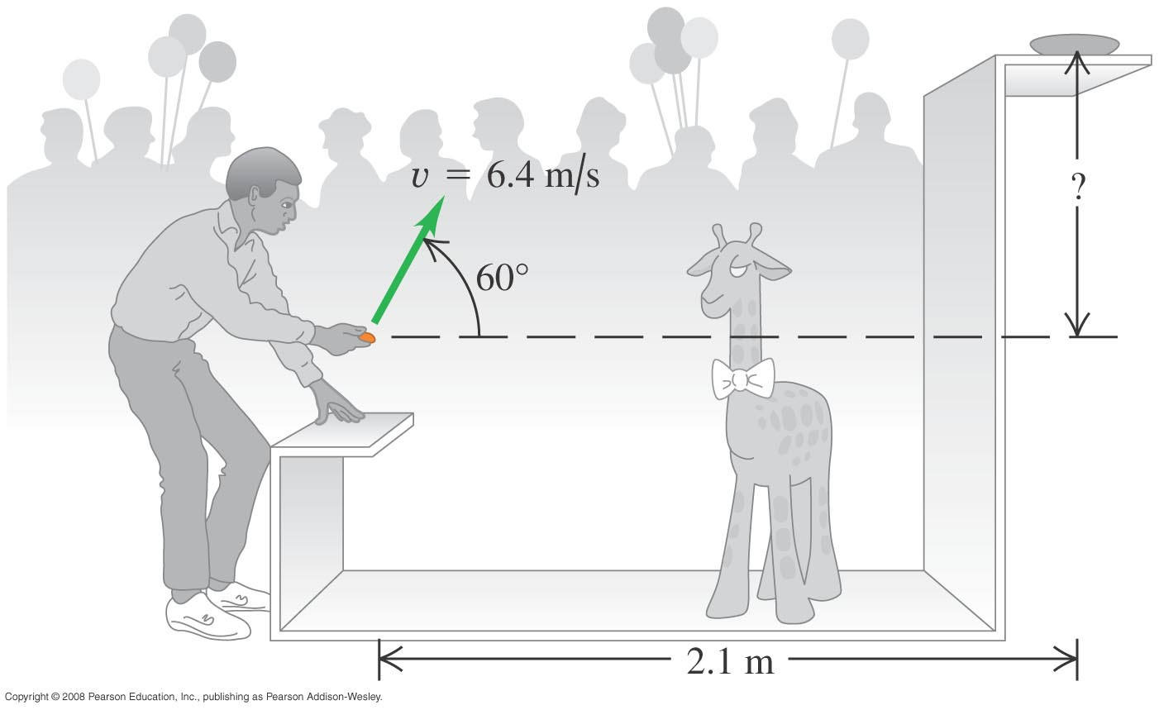
Projectile Motion: Win the Prize

Slide 12
End-of-Chapter Skills Check
  To learn the concepts behind projectile motion.
  To know that projectile motion could be easily treated as a combination of horizontal motion with constant velocity and vertical motion with constant acceleration.

